Slide 1
Assembly Language: Flow Control
CSE 315
Microprocessors, Microcontrollers, and Embedded Systems

Slide 2
Outline
The Status Flags
Control Flow Structure
Conditional Jump
Unconditional Jump
Control Flow Structures
IF-THEN
IF-THEN-ELSE
CASE
Branches with Compound Conditions
Looping

Slide 3
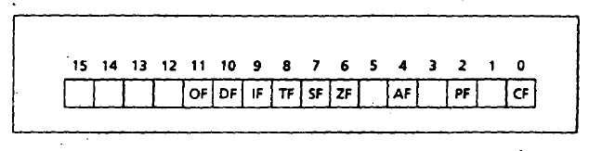
The FLAGS Register

Slide 4
The FLAGS Register flags
Flag | Intel Mnemonic
Overflow | OF
Sign | SF
Zero | ZF
Auxiliary Carry | AF
Parity | PF
Carry | CF

Slide 5
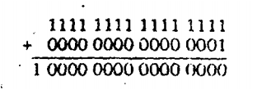
Overflow Flag
Unsigned Overflow (CF)

Slide 6

Overflow Flag
Signed Overflow (OF)

Slide 7
OF & CF
OF = 1 for signed overflow, CF =1 for unsigned overflow.
CF = 1, if there is a carry out of the msb on addition. However, CF is not affected by INC or DEC.
OF = 1, if we add two numbers of the same sign and the result is of different sign. If we add two numbers of the different sign, there is no way of overflow.
If the carry into and out of msb don’t match OF = 1

Slide 8
ZF, SF and PF
ZF = 1 if the result is zero.
SF = 1, if the msb of result is 1.
PF = 1, if the low byte of the result has an even number of 1s (even parity).

Slide 9
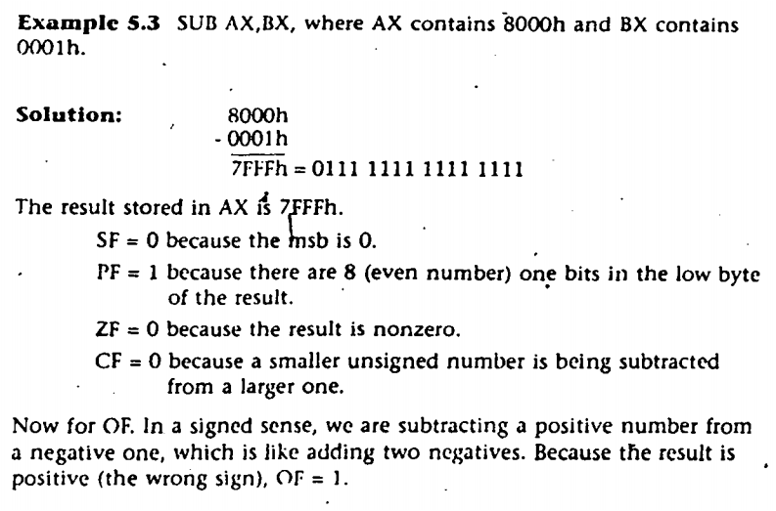
Effect of the flags

Slide 10
Outline
The Status Flags
Control Flow Structure
Conditional Jump
Unconditional Jump
Control Flow Structures
IF-THEN
IF-THEN-ELSE
CASE
Branches with Compound Conditions
Looping

Slide 11
An Example of Jump
Display the entire IBM character set
.MODEL SMALL
.CODE
.STARTUP
MOV AH, 2 ; display char function
MOV CX, 256 ; no. of chars to display
MOV DL, 0 ; DL has ASCII code for null char
PRINT_LOOP:
INT 21H ; display a char
INC DL ; increment ASCII code
DEC CX ; decrement counter
JNZ PRINT_LOOP ; keep going if CX not 0
.EXIT
END
Section 6-1 of Assembly Language Programming Book

Slide 12
Conditional Jumps
JNZ is an example of conditional jump instruction
Checks the Z flag. If Z = 0 then jump to the location
Three categories of conditional jumps
Signed jumps, for signed interpretation
Unsigned jumps, for unsigned interpretation
Single-flag jumps, operates on settings of individual flags

Slide 13
The CMP Instruction
The jump condition is often preceded by the CMP (compare) instruction
CMP destination, source
It is like SUB, except that destination is not changed
Destination may not be a constant
The result is not stored but the flags are affected
CMP AX, BX
JG BELOW
If AX = 7FFFh, and BX = 0001h, the result is 7FFFh - 0001h = 7FFEh.
ZF = 0, SF = OF = 0, JG (jump if greater) is satisfied,
so control transfers to label BELOW

Slide 14
Signed Conditional Jumps
Symbol | Description | Condition for jumps
JG/JNLE | Jump if greater than Jump if not less than or equal to | ZF = 0 and SF = OF
JGE/JNL | Jump if greater than or equal to Jump if not less than | SF = OF
JL/JNGE | Jump if less than Jump if not greater than or equal to | SF <> OF
JLE/JNG | Jump if less than or equal Jump if not greater than | ZF = 1 or SF <> OF

Slide 15
Unsigned Conditional Jumps
Symbol | Description | Condition for jumps
JA/JNBE | Jump if above Jump if not below or equal | CF = 0 and ZF = 0
JAE/JNB | Jump if above or equal Jump if not below | CF = 0
JB/JNAE | Jump if below Jump if not above or equal | CF = 1
JBE/JNA | Jump if below or equal Jump if not above | CF = 1 or ZF = 1

Slide 16
Single-Flag Jumps
Symbol | Description | Condition for jumps
JE/JZ | Jump if equal Jump if equal to zero | ZF = 1
JNE/JNZ | Jump if not equal Jump if not zero | ZF = 0
JC | Jump if carry | CF = 1
JNC | Jump if no carry | CF = 0
JO | Jump if overflow | OF = 1
JNO | Jump if no overflow | OF = 0
JS | Jump if sign negative | SF = 1
JNS | Jump if nonnegative sign | SF = 0
JP/JPE | Jump if parity even | PF = 1
JNP/JPO | Jump if parity odd | PF = 0

Slide 17
Range of a Conditional Jump
The destination label must precede the jump instruction by no more than 126 bytes
Or, follow by no more than 127 bytes
LABEL:
; statement
; statement
JNZ LABEL
JZ LABEL
; statements
; statements
LABEL:
; statement
; statement
126 bytes
127 bytes

Slide 18
Signed vs. Unsigned Jumps
Each signed jump corresponds to an analogous unsigned jump
e.g. signed JG corresponds to unsigned JA
Use depends on the interpretation
The jumps operate on different flags
Symbol | Description | Condition for jumps
JG/JNLE | Jump if greater than Jump if not less than or equal to | ZF = 0 and SF = OF
JA/JNBE | Jump if above Jump if not below or equal | CF = 0 and ZF = 0

Slide 19
Signed vs. Unsigned Jumps cont.
For signed interpretation, let us take
AX = 7FFFh, BX = 8000h and we execute
Then, even though 7FFFh > 8000h in a signed sense, the program does not jump to BELOW
Because 7FFFh < 8000h in an unsigned sense
We used JA, which is the unsigned jump
CMP AX, BX
JA BELOW

Slide 20
The JMP Instruction
JMP (jump) instruction causes an unconditional jump
The syntax is:
JMP can be used to get around the range restriction
JMP destination
TOP:
; body of the loop, say 2 instructions
DEC CX ; decrement counter
JNZ TOP ; keep looping if CX > 0
MOV AX, BX
TOP:
; body of the loop contains many instructions
DEC CX
JNZ BOTTOM
JMP EXIT
BOTTOM:
JMP TOP
EXIT:
MOV AX, BX
Section 6-3: Assembly Language Programming

Slide 21
Outline
Control Flow Structure
Conditional Jump
Unconditional Jump
Control Flow Structures
IF-THEN
IF-THEN-ELSE
CASE
Branches with Compound Conditions
Looping

Slide 22

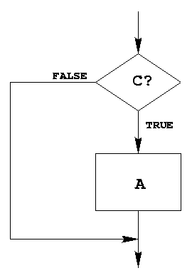
IF-THEN Structure
Replace the number in AX by its absolute value.
IF AX < 0 THEN
replace AX by –AX
END_IF
CMP AX, 0 ; AX < 0?
JNL END_IF
NEG AX
END_IF:
Example 6-2: Assembly Language Programming

Slide 23
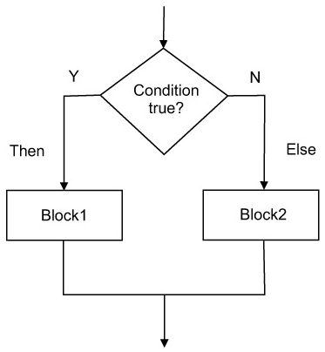
IF-THEN-ELSE Structure
Suppose AL and BL contains ASCII characters.
Display the one that comes first in the character sequence
IF AL <= BL THEN
display the character in AL
ELSE
display the character in BL
END_ID
MOV AH, 2 ; prepare to display
CMP AL, BL ; AL <= BL?
JNBE ELSE_
MOV DL, AL
JMP DISPLAY
ELSE_:
MOV DL, BL
DISPLAY:
INT 21h
END_IF:
Example 6-3: Assembly Language Programming

Slide 24
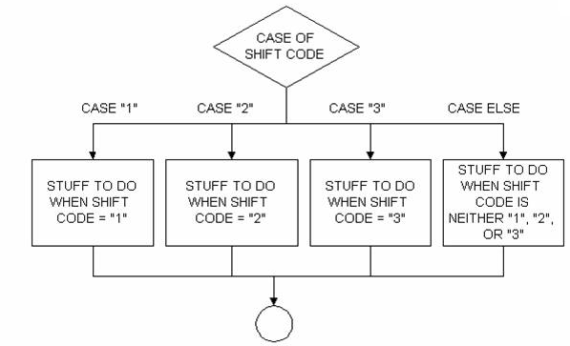
CASE
A CASE is a multi-way branch structure
CASE expression
1: statements_1
2: statements_2
*
*
n: statements_n
END_CASE

Slide 25
CASE Example
If AX contains a negative number, put -1 in BX;
If AX contains 0, put 0 in BX;
If AX contains a positive number, put 1 in BX.
CASE AX
< 0: put -1 in BX
= 0: put 0 in BX
> 0: put 1 in BX
END_CASE
CMP AX, 0 ; test AX
JL NEGATIVE ; AX < 0
JE ZERO ; AX = 0
JG POSITIVE ; AX > 0
NEGATIVE:
MOV BX, -1 ; put -1 in BX
JMP END_CASE ; and exit
ZERO:
MOV BX, 0 ; put 0 in BX
JMP END_CASE ; and exit
POSITIVE:
MOV BX, 1 ; put 1 in BX
END_CASE:
Example 6-4: Assembly Language Programming

Slide 26
More CASE Example
If AL contains 1 or 3, display “o” for odd;
If AL contains 2 or 4, display “e” for even;
CASE AL
1, 3: display ‘o’
2, 4: display ‘e’
END_CASE
CMP AL, 1 ; AL = 1?
JE ODD ; yes, display ‘o’
CMP AL, 3 ; AL = 3?
JE ODD ; yes, display ‘o’
CMP AL, 2 ; AL = 2?
JE EVEN ; yes, display ‘e’
CMP AL, 4 ; AL = 4?
JE EVEN ; yes, display ‘e’
JMP END_CASE
ODD:
MOV DL, ‘o’ ; get ‘o’
JMP DISPLAY ; go to display
EVEN:
MOV DL, ‘e’ ; get ‘e’
DISPLAY:
MOV AH, 2 ; char display function
INT 21h ; display character
END_CASE
Example 6-4: Assembly Language Programming

Slide 27
Outline
Control Flow Structure
Conditional Jump
Unconditional Jump
Control Flow Structures
IF-THEN
IF-THEN-ELSE
CASE
Branches with Compound Conditions
Looping

Slide 28
Branches with Compound Conditions
Branching condition in an IF or CASE can be
condition_1 AND condition_2
condition_1 OR condition_2
First one is AND condition
Second one is OR condition

Slide 29
AND Conditions
Read a character, and if it’s an uppercase letter, display it.
Read a character into AL
IF (‘A’ <= character ) and (character <= ‘Z’) THEN
display the character
END_IF
MOV AH, 1 ; read character function
INT 21h ; char in AL
CMP AL, ‘A’ ; char >= ‘A’
JNGE END_IF ; no, exit
CMP AL, ‘Z’ ; char <= ‘Z’
JNLE END_IF ; no, exit
MOV DL, AL ; get char
MOV AH, 2 ; display character function
INT 21h ; display the character
END_IF:
Example 6-6: Assembly Language Programming

Slide 30
OR Conditions
Read a character, and if it’s ‘y’ or ‘Y’, display it; otherwise, terminate the program
Read a character into AL
IF (character = ‘y’) or (character = ‘Y’) THEN
display the character
ELSE
terminate the program
END_IF
MOV AH, 1 ; read character function
INT 21h ; char in AL
CMP AL, ‘Y’ ; char = ‘Y’
JE THEN ; yes, display the char
CMP AL, ‘y’ ; char = ‘y’
JE THEN ; yes, display the char
JMP ELSE_
THEN:
MOV DL, AL ; get the char
MOV AH, 2 ; display character function
INT 21h ; display the character
ELSE_:
Example 6-7: Assembly Language Programming

Slide 31
Looping

Slide 32
Outline
Control Flow Structures
FOR Loop
WHILE Loop
REPEAT-UNTIL Loop
Programming with Higher Level Structures

Slide 33
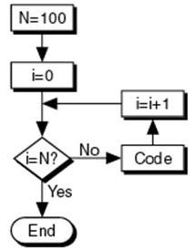
FOR Loop
Write a program to display a row of 80 stars ‘*’
FOR 80 times DO
display ‘*’
END_FOR
MOV CX, 80 ; number of ‘*’ to display
MOV AH, 2 ; char display function
MOV DL, ‘*’ ; char to display
TOP:
INT 21h ; display a star
LOOP TOP ; repeat 80 times
Example 6-8: Assembly Language Programming

Slide 34
Caution!
‘For loop’ implemented using LOOP is executed at least once
If CX contains 0 when loop is entered, the LOOP instruction will decrement CX to FFFFh
The loop will be executed 65535 more times
JCXZ (jump if CX is zero) may be used
JCXZ SKIP
TOP:
; body of the loop
LOOP TOP
SKIP:

Slide 35
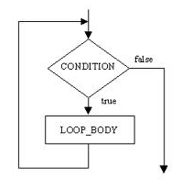
WHILE Loop
Write a program to count the characters in an input line
Initialize count to 0
Read a character
WHILE character <> carriage_return DO
count = count + 1
read a character
END_WHILE
WHILE condition DO
statements
END_WHILE
MOV DX, 0 ; DX counts the characters
MOV AH, 1 ; read char function
INT 21h ; read a char in AL
WHILE_:
CMP AL, 0DH ; CR?
JE END_WHILE
INC DX
INT 21h
JMP WHILE_
END_WHILE:
Example 6-9: Assembly Language Programming

Slide 36
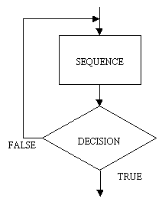
REPEAT Loop
REPEAT
statements
UNTIL condition
Write a program to read characters until a blank/space is read
REPEAT
read a character
UNTIL character is a blank
MOV AH, 1 ; read char function
REPEAT:
INT 21h ; read a char in AL
CMP AL, ‘ ‘ ; a blank?
JNE REPEAT ; no, keep reading
Example 6-10: Assembly Language Programming

Slide 37
Outline
Control Flow Structures
IF-THEN
IF-THEN-ELSE
CASE
FOR Loop
WHILE Loop
REPEAT-UNTIL Loop
Programming with Higher Level Structures

Slide 38
Programming with High Level Structures
Problem
Prompt the user to enter a line of text. On the next line, display the capital letter entered that comes first alphabetically and the one that comes last. If no capital entered, display “No capital letters”.
Type a line of text:
THE QUICK BROWN FOX JUMPED
First capital = B Last capital = X

Slide 39
Top-down Program Design
Divide the problem into sub-problems
Display the opening message
Read and process a line of text
Display the results

Slide 40
Start the Program
Type a line of text:
THE QUICK BROWN FOX JUMPED
First capital = B Last capital = X
.MODEL SMALL
.STACK 100H
.DATA
PROMPT DB ‘Type a line of text’, 0DH, 0AH, ‘$’
NOCAP_MSG DB 0DH, 0AH, ‘No capitals $’
CAP_MSG DB 0DH, 0AH, ‘First capital = ‘
FIRST DB ‘]’
DB ‘ Last capital = ‘
LAST DB ‘@ $’
.CODE
.STARTUP
Follows ‘Z’ in ASCII sequence
Precedes ‘A’ in ASCII sequence
@ABCDE………………………………..XYZ]
LAST
FIRST

Slide 41
Step 1. Display the opening message
.DATA
PROMPT DB ‘Type a line of text’, 0DH, 0AH, ‘$’
; initialize DS
MOV AX, @DATA
MOV DS, AX
; display opening message
MOV AH, 9 ; display string function
LEA DX, PROMPT ; get opening message
INT 21h ; display it

Slide 42
Step 2: Read and Process a Line of Text
Read a character
WHILE character is not carriage return DO
IF character is a capital letter (*) THEN
IF character precedes first capital THEN
first capital = character
END_IF
IF character follows last capital THEN
last capital = character
END_IF
END_IF
Read a character
END_WHILE
Line (*) is actually an AND condition:
IF (‘A’ <= character) AND (character <= ‘Z’)

Slide 43
Step 2: Read and Process a Line of Text
Read a character
WHILE character is not carriage return DO
IF character is a capital letter (*) THEN
IF character precedes first capital THEN
first capital = character
END_IF
IF character follows last capital THEN
last capital = character
END_IF
END_IF
Read a character
END_WHILE
MOV AH, 1
INT 21h
WHILE_:
CMP AL, 0DH
JE END_WHILE
CMP AL, ‘A’
JNGE END_IF
CMP AL, ‘Z’
JNLE END_IF
CMP AL, FIRST ; char < FIRST or ‘]’
JNL CHECK_LAST
MOV FIRST, AL
CHECK_LAST:
CMP AL, LAST ; char > LAST or ‘@’
JNG END_IF
MOV LAST, AL
END_IF:
INT 21H
JMP WHILE_
END_WHILE:
Line (*) is actually an AND condition:
IF (‘A’ <= character) AND (character <= ‘Z’)
@ABCDE………………………………..XYZ]
LAST
FIRST

Slide 44
Step 3: Display The Results
IF no capitals were typed THEN
display “no capitals”
ELSE
display first capital and last capital
END_ID
MOV AH, 9 ; display string function
CMP FIRST, ‘]’
JNE CAPS ; no, display results
LEA DX, NOCAP_MSG
JMP DISPLAY
CAPS:
LEA DX, CAP_MSG
DISPLAY:
INT 21H
.EXIT
END
@ABCDE………………………………..XYZ]
LAST
FIRST

Slide 45
References
Ch 5, 6 Assembly Language Programming – by Yu and Marut

